Slide 1
Lecture 14
Design Principles #2
Design principles
Stimulus intensity
Proportion
Screen complexity
Resolution/closure
Usability goals
Heim, Chapters 6.7-6.11

Slide 2
Learning Objectives
To be able to apply design principles in the context of user interface design tasks
To understand the role of intensity in perception of content
To be able to assess the relative complexity of screen designs

Slide 3
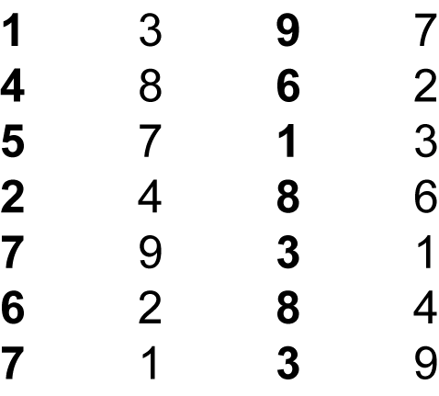
Other Principles of Perception - Stimulus Intensity
We respond first to the intensity of a stimulus and only then do we begin to process its meaning.

Slide 4
Stimulus versus cognition
In general, the ‘hard wired’ responses to stimulus will be processed quicker than those that require processing of coded information

Slide 5
Other Principles of Perception – Proportion
Proportion can be used to represent logical hierarchies
Heading Level 1
Heading Level 2
Heading Level 3
Heading Level 4
Heading Level 5
Heading Level 6

Slide 6
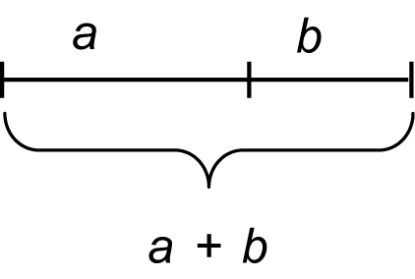
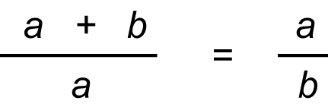
Other Principles of Perception – Proportion
Golden Ratio - The golden ratio expresses the relationship between two aspects of a form such as height to width, about 1.618
  Actually (1+sqrt(5)) / 2

Slide 7
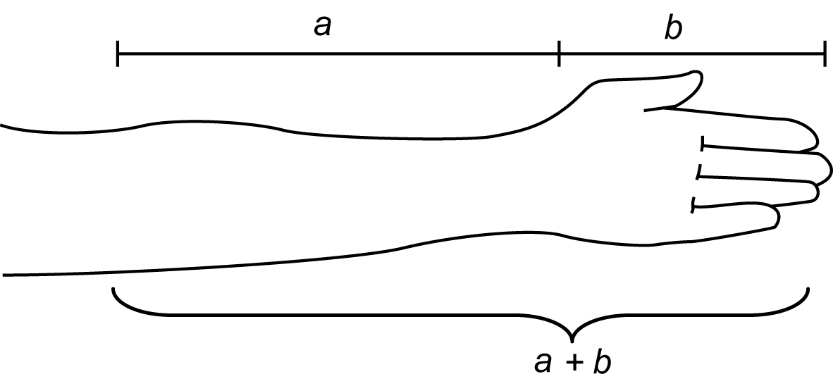
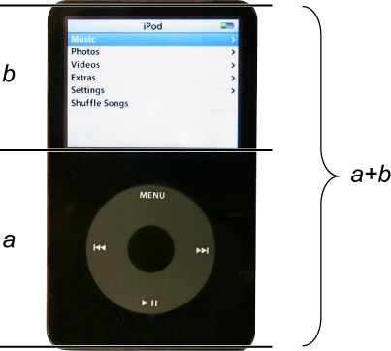
Other Principles of Perception – Proportion
Golden Ratio
  Occurs in nature, common in architecture
  Widely believed to be inherently pleasing

Slide 8
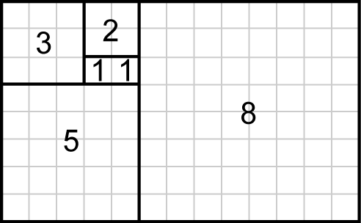
Other Principles of Perception – Proportion
Fibonacci - A sequence of numbers in which each number is the sum of the two preceding numbers.
  The relationship between the numbers in the Fibonacci series is similar to the golden ratio
1, 1, 2, 3, 5, 8, 13, 21, 34, 55, 89, 144, 233, 377, 610, 987, …

Slide 9

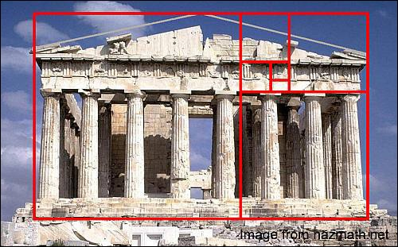

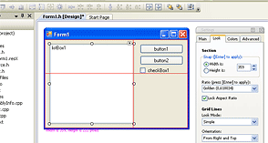
Golden ratios & Fibonacci
www.mathsisfun.com
journalofcosmology.com
www.atrise.com

Slide 10
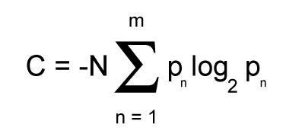
Other Principles of Perception - Screen Complexity
The measure of complexity developed by Tullis (1984) can be used to calculate the relative complexity, and therefore the difficulty, of a design.
  This measure of complexity uses information theory (Shannon & Weaver, 1949)

Slide 11
Other Principles of Perception - Screen Complexity
Formula for calculating the measure of complexity
C, complexity of the system in bits
N, total number of events (widths or heights)
m, number of event classes (number of unique widths or heights)
p_{n}, probability of occurrence of the n^{th} event class
(based on the frequency of events within that class)

Slide 12
Half time entertainment
Bit to close to Novapay for comfort?
https://www.youtube.com/watch?v=eXbje3Czh4k

Slide 13
Other Principles of Perception - Screen Complexity
More practical (approximate) way to calculate the measure of complexity for a particular screen, do the following:
  Count the number of elements
  Count the number of columns (horizontal alignment points)
  Count the number of rows (vertical alignment points)
  Sum up these three counts for a complexity score

Slide 14
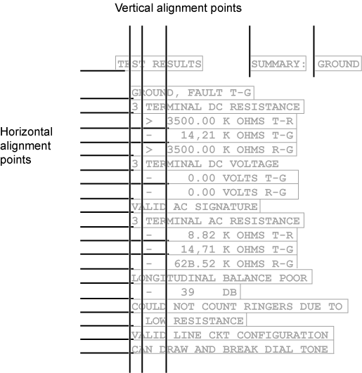
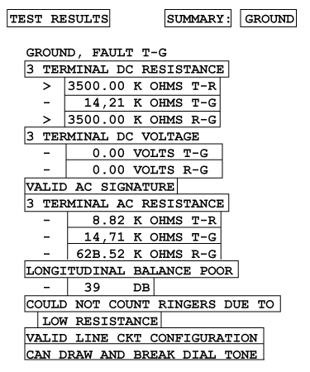
Other Principles of Perception - Screen Complexity
Labelling from the text is a bit confused, but conveys the general idea

Slide 15
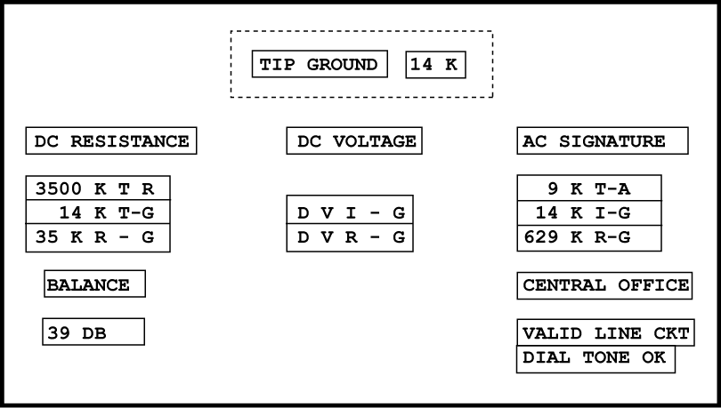
Other Principles of Perception - Screen Complexity
Redesigned screen
  Original had 22 elements + 6 horizontal alignment points (columns) + 20 vertical alignment points (row) = 48 complexity
  New design has 18, 7 and 8 respectively = 33 complexity (31% reduction)

Slide 16
About screen complexity
More important as a heuristic than as a precise quantity
  Higher complexity places more ‘load’ on the eye, and hence the brain
  Gives a good indication of the relative complexity of alternative designs

Slide 17
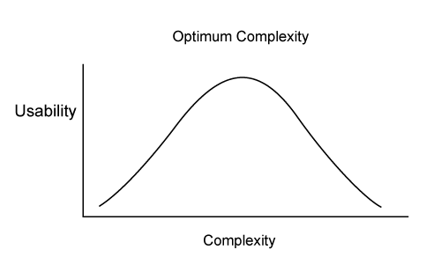
Other Principles of Perception - Screen Complexity
Complexity vs. Usability
  Comber and Maltby (1997) found that both overly simple and overly complex screens were low in usability
  This could, for instance, be due to lack of opportunity to form logical groupings in very low complexity designs (lecture on grouping later in the semester)

Slide 18
Other Principles of Perception - Screen Complexity
Comber and Maltby found tradeoffs between usability and complexity:
  As complexity decreased, predictability increased.
  As complexity decreased, it became harder to differentiate among screen objects; the screen became artificially regular.
  Decreased complexity meant that there were fewer ways to group objects.
  Excessive complexity made screens look artificially irregular.
  Increased complexity could occur from increased utility.

Slide 19
Complexity and usability
In general, use layout as a code
  If you have something to say, then do things that add complexity such as indenting a group, putting a box around it, or having some groups shorter than others
  If there’s no ‘message’ intended, keep it simple with uniform margin and working across as well as down where screen width permits
However
  If you find yourself with large undifferentiated areas (e.g. a huge grid of captions and entry fields), the user will glaze over
  Find some logical groupings to add meaning
  (anybody try to census form recently? – very thoughtful!)

Slide 20
Complexity and usability (contd.)
KISS (keep it simple, stupid)
  Obviously, if you need less screen components, then the screen will be simpler
    And faster both for user comprehension as well as actual user work if you can eliminate an input field!
Notice an interaction with ‘progressive disclosure’ here
  Can show a simpler screen and only confront user with more complexity if they ask for it

Slide 21
Other Principles of Perception - Resolution/Closure
Resolution/Closure - Relates to the perceived completion of a user’s tasks.
  When the user’s objective is satisfied, he or she will consider the task complete and move on to the next goal
It’s good to create closure in the dialog structure
  Frees the user’s attention
  Satisfying to give feedback

Slide 22
Caution on closure
Be sure the task is really completed before your user moves on
  A problem with ATM machines is that the user may walk away when they’ve gotten their cash, and leave their card in the machine!
    They went for cash: cash = closure
  Textbook suggests to swipe (or insert and withdraw) card so it gets put away in advance of closing step
    Actually a lot of machines (e.g. PackNSave self-serve fuel pump) do this, although my WestPac ATM instead just beeps at the end of the transaction (no matter how quickly I retrieve my card – Arg!)
    And lots of people forget their receipt at the PackNSave pump (prints after they got their fuel! [probably didn’t want it anyway])

Slide 23
Putting usability goals into effect
User-centred design (UCD) puts the focus on the user’s tasks and goals
Generally-accepted goals for an interface are that it be:
  Understandable
  Learnable
  Effective / useful
  Efficient / usable
Hard to argue with that! But how do we run a project such that usability goals are achieved?

Slide 24
Usability Goals – Principles - Guidelines
One approach is to articulate key project-specific pathways from goals, to principles to guidelines for the development team – for example…
Usability Goal—Easy to use
  One of the most important goals of user-centered design is to make things easy to use. Let’s say we’re confident that this is very important to our users.
Design Principle—Simplicity
  Simple things require little effort and can often be accomplished without much thought. If interaction designs are guided by the principle of simplicity, they will be easier to use.

Slide 25
Usability Goals – Principles – Guidelines (contd.)
Project Guideline—All dialogue boxes should present only the basic functions that are most often used and that other, less used functions can be accessed using an expandable dialogue with a link for “More Options.”
This is something that could be communicated to even a large team and used as a design guideline and checked in heuristic evaluations and walkthroughs

Slide 26
Summary
Intensity is perceived before semantics
Consider classically pleasing proportions
Aim for simple interfaces, but not simplistic
  Complexity can be measured and contrasted across alternative designs
Understand and plan for where your interface creates closure
Projects (esp. when large) should choose focus usability goals and related principles to formulate guidelines

